Slide 1
Getting to Know AntiPatterns
Emily Christiansen

Slide 2
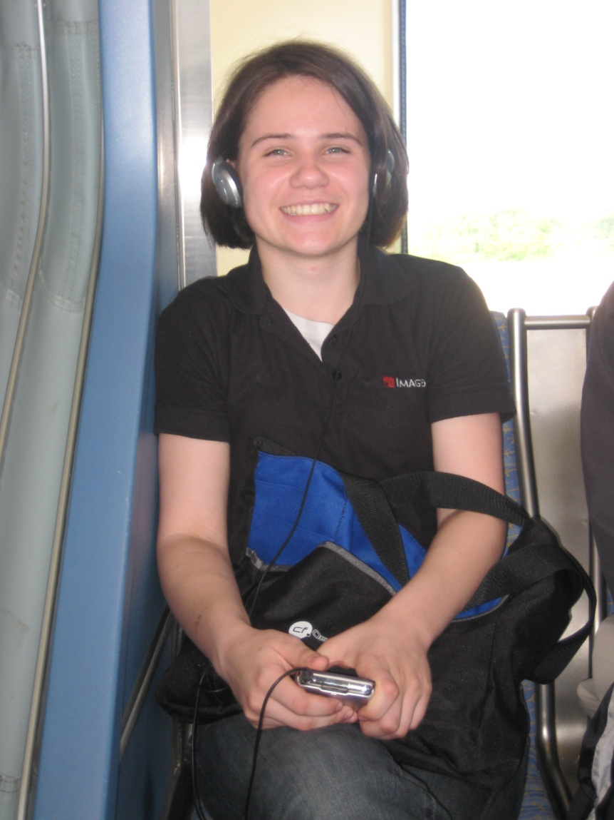
About Me
Graduated from University of Minnesota, Morris 2007
Java Developer for 2 years
ColdFusion Developer for 1 Year
Web Developer at ImageTrend
Sings in Saint Paul Vocal Forum
Email: echristiansen@imagetrend.com
Twitter: egchristiansen

Slide 3
What You Should Learn
What are AntiPatterns?
How to properly leverage AntiPatterns
Some guidelines on refactoring
Tools to help you out / Prevention strategies

Slide 4
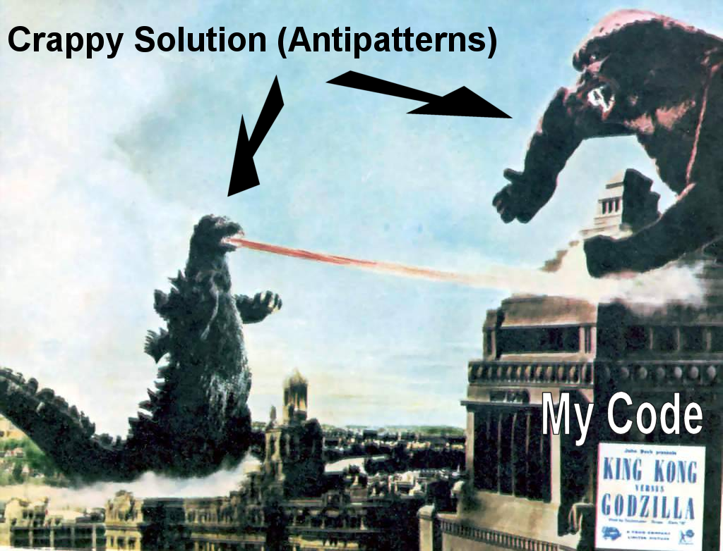
This is only half of the story

Slide 5
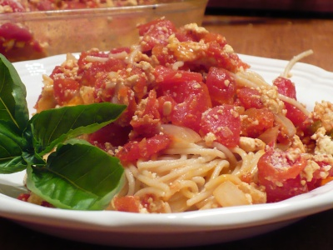
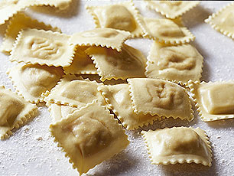
Actually…
“The essence of an AntiPattern is two solutions… The first solution is problematic … The second solution is called the refactored solution.” [BMMM]

Slide 6
Benefits of Understanding AntiPatterns
Help developers recognize problems
Provide common vocabulary
Also provide proven solution
SAVE EXISTING PROJECTS!

Slide 7
Contrasting with Design Patterns
AntiPatterns and Design Patterns are related
Design patterns assume from-scratch programming
Design patterns become AntiPatterns in the wrong context
AntiPatterns start with a problematic solution, and refactor it

Slide 8
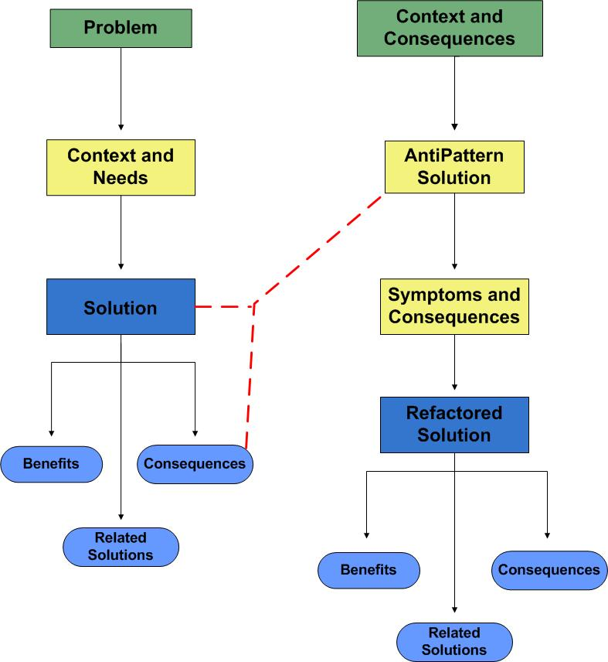

Slide 9
Refactoring
“The process of changing a software system in such a way that it does not alter the external behavior of the code yet improves its general structure” [FBBO ]

Slide 10
Some Refactoring Tips
Do it iteratively
Leave scaffolding
Test as you go

Slide 11
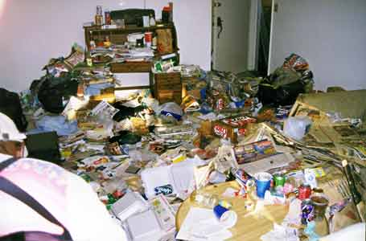
Functional Decomposition
One main routine calling many subroutines
Subroutines become components
Your code base looks like this:

Slide 12
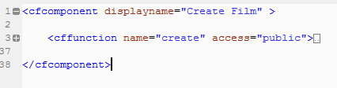
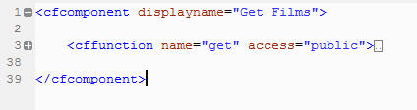
Subroutines as Components

Slide 13
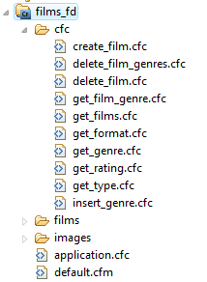
Large Domain Model

Slide 14
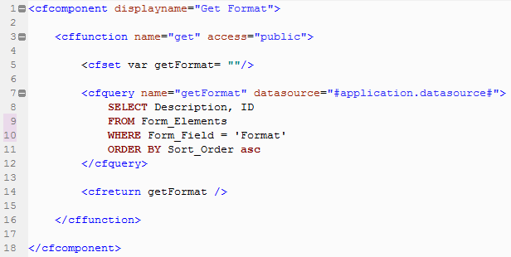
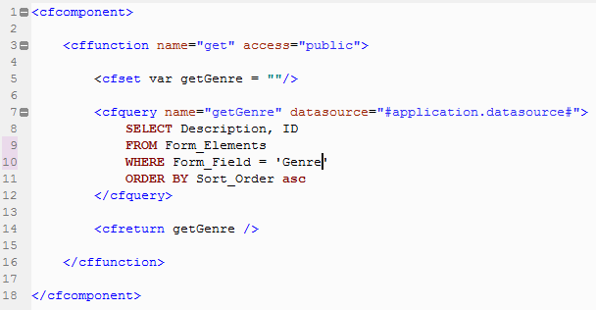
Repetition

Slide 15
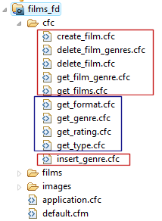
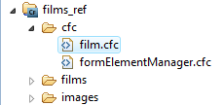
Group Methods
Before
After

Slide 16
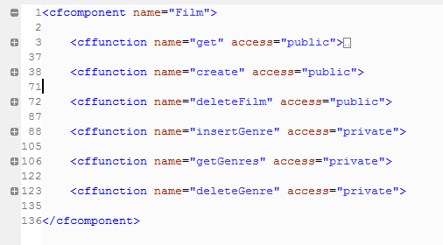
Combine Components
Before
After

Slide 17
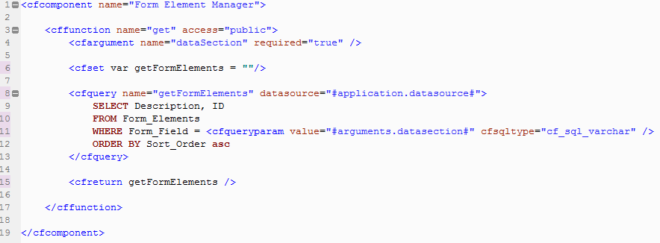
Before
After

Slide 18
What Changed?
Methods are grouped intuitively
Code base is cleaner
Easier to find functions

Slide 19
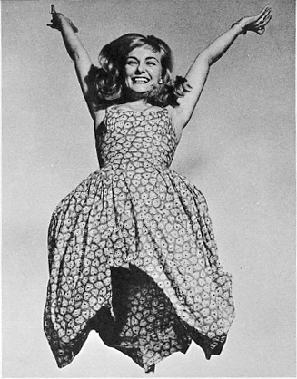
Life is good.

Slide 20

Until…
Wouldn’t it be dreamy if I knew
what room my movies were in?
Suddenly things aren’t so simple

Slide 21

God Object
A component that knows or does everything.

Slide 22
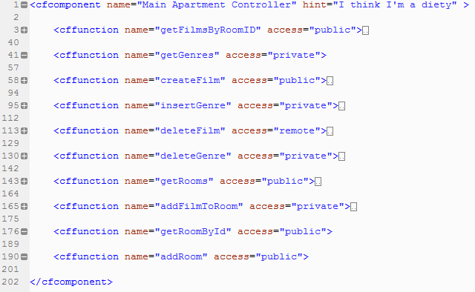
All Logic in One Place

Slide 23
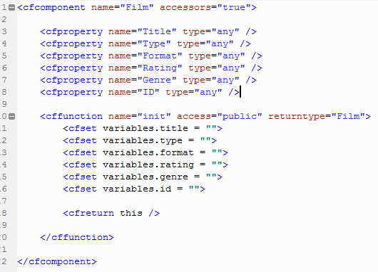
Lazy Film

Slide 24
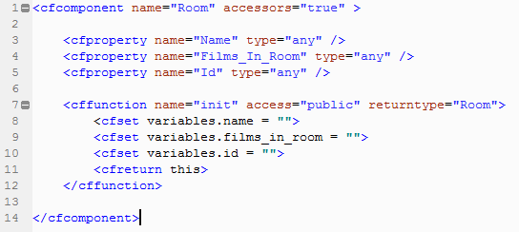
Lazy Room

Slide 25
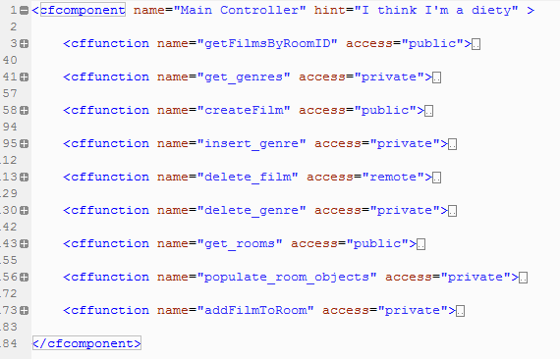
Coupling

Slide 26
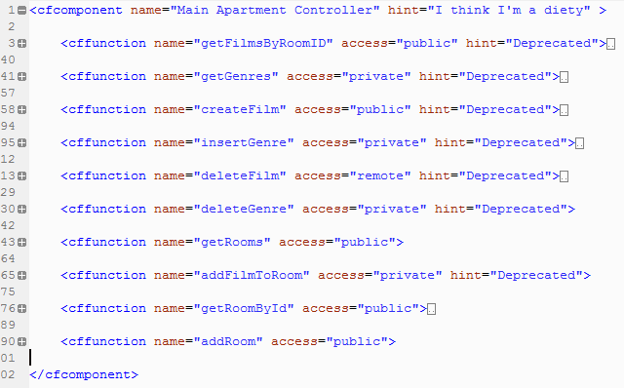
Group Functions

Slide 27
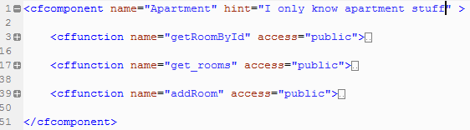
Single Responsibility

Slide 28
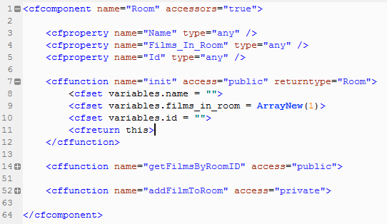
Components are Useful

Slide 29
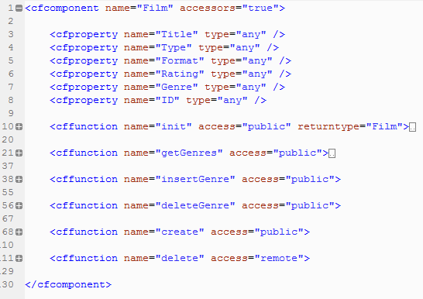
Components are Useful

Slide 30
What changed?
Methods and variables grouped more intuitively
Each component only knows about itself
Maintenance does not affect the entire system
Easy to find functions
Components communicate directly

Slide 31
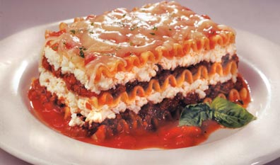
Anemic Domain Model
All logic implemented in a service layer.
Domain Objects are “Bags of Getters and Setters”

Slide 32
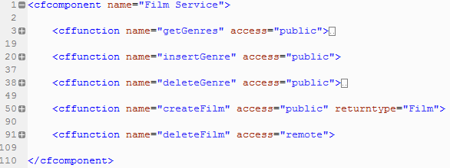
All Logic in Service Layer

Slide 33
Glorified Struct

Slide 34
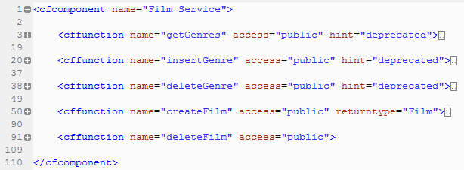
Decide what is Business Logic
This can stay in the service layer!

Slide 35
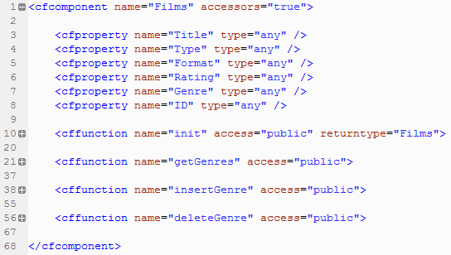
Move The Other Methods Out

Slide 36
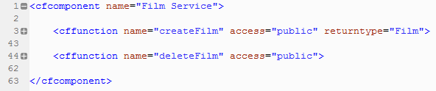
Remove the Deprecated Code

Slide 37
What Changed?
Only business logic in the service
Film object has control over its genre

Slide 38
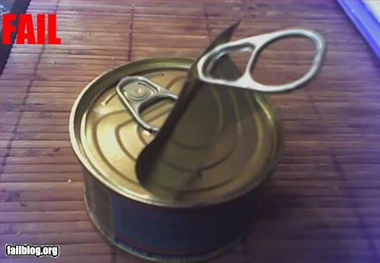
Poltergeist
“Components with limited responsibilities and roles to play in the system” [Brown 104]

Slide 39
Symptoms of Poltergeist
Exist to call other components
Components are stateless and not persisted
Don’t confuse with the controller layer

Slide 40
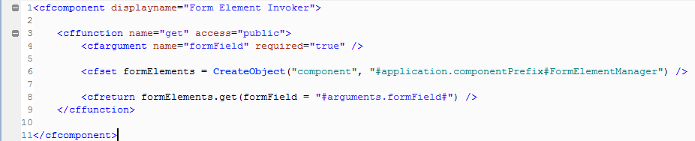
Unnecessary Abstraction

Slide 41
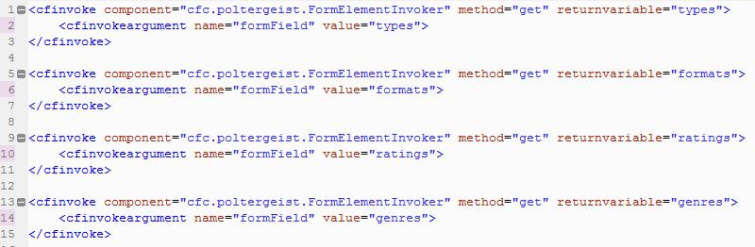
CFInvoke
Components created with CFInvoke are stateless and have to be re-created each time.
Forces Poltergeist symptoms on all components

Slide 42
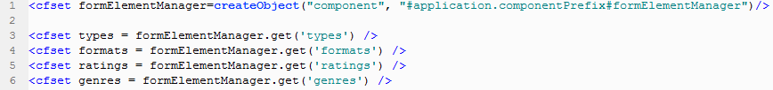
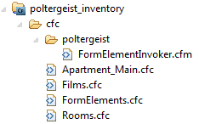

Refactoring
Simply remove the poltergeist component and invoke the other components directly

Slide 43
What Changed?
Not recreating components multiple times
Less clutter in the code base
No unnecessary abstraction

Slide 44
Many More AntiPatterns…
Boat Anchor
Circular dependency
Object Cesspool
Object Orgy
Spaghetti Code
Stovepipe

Slide 45
Conclusions
AntiPatterns do not only describe bad code.
AntiPatterns are powerful tools
Mostly stem from misunderstandings and lack of communication

Slide 46
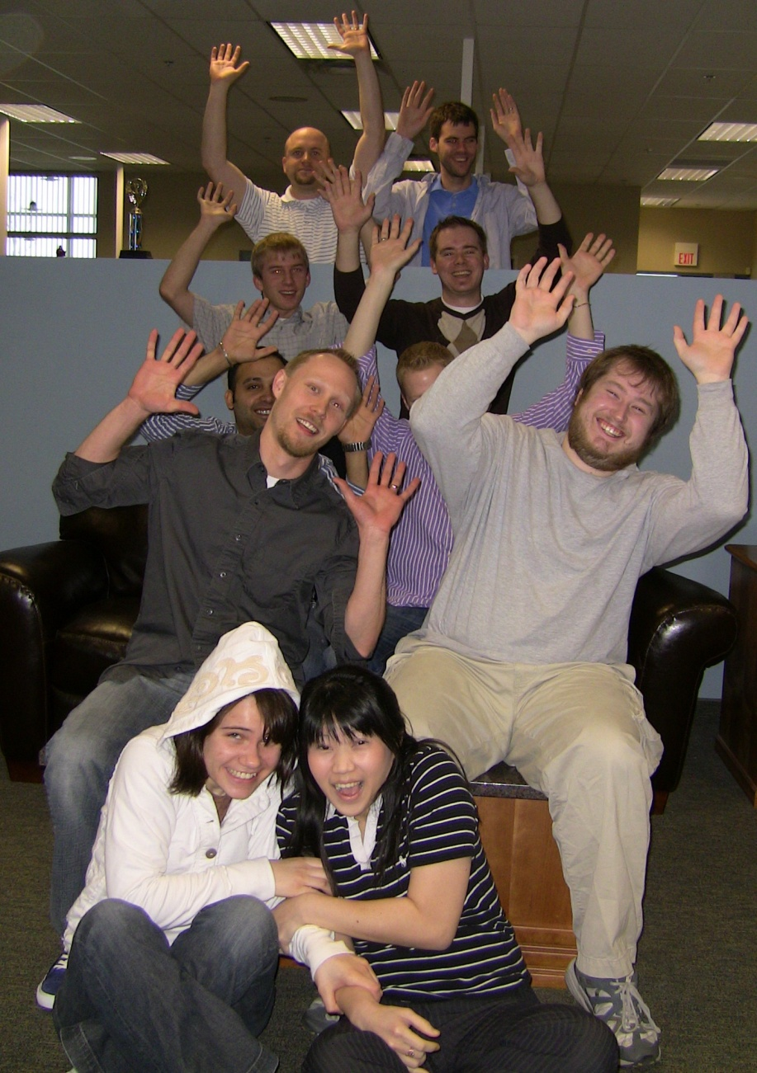
Teams

Slide 47
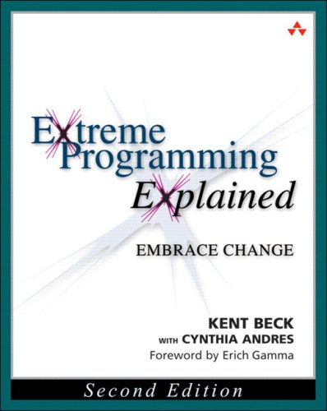
eXtreme and Agile
Relies on communication
Relies on unit testing.
Short development cycles
Involves the client

Slide 48



Code Review
Or you can do a diff with SVN or your version control software.

Slide 49

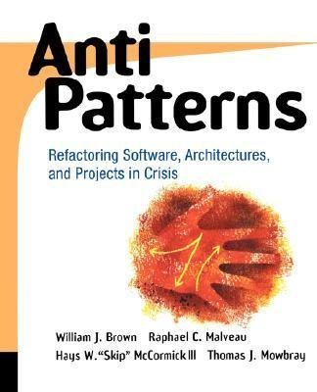
Further Reading

Slide 50

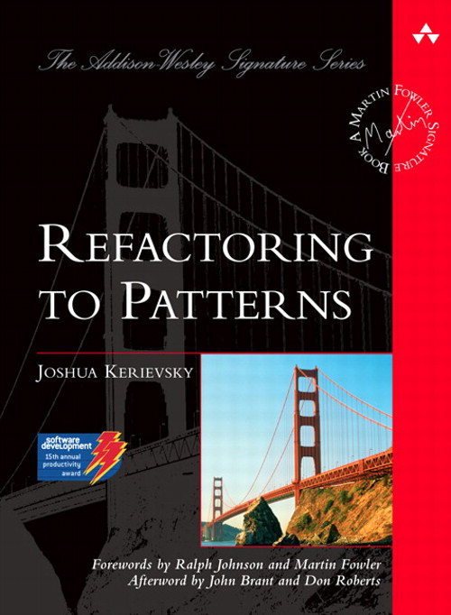
Refactoring Books

Slide 51
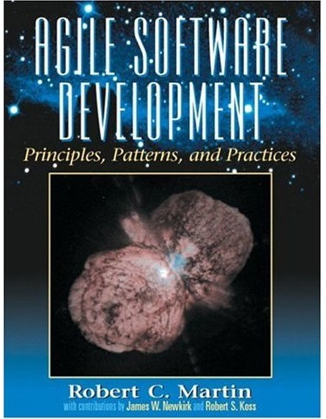

Other Good Books

Slide 52
Thank you!
My team: Ryan Arneson, Dan Nelson, Dustin Blomquist, Michael Olson, Joan Hendrawan, Ted Steinmann, Michael Sullivan, Kevin Spinar, Chetan Kapoor, Michael Patock
ImageTrend User Group and Colder Fusion: Thanks for letting me practice!
Data Recovery and SVN Setup Help: Tim Meyer, Ted Steinmann

